Slide 1
Drought Impact on Maple Syrup Production
Team B4: Chris Chang, Jacinto Lemarroy, Mengxin Li, Shiyu Ye, Ying Li

Slide 2
Table of Contents
Intro and Problem Statement
Data Description and Source
Data Cleaning and Manipulation
Exploratory Data Analysis
Regression Analysis
Conclusion & Limitations

Slide 3
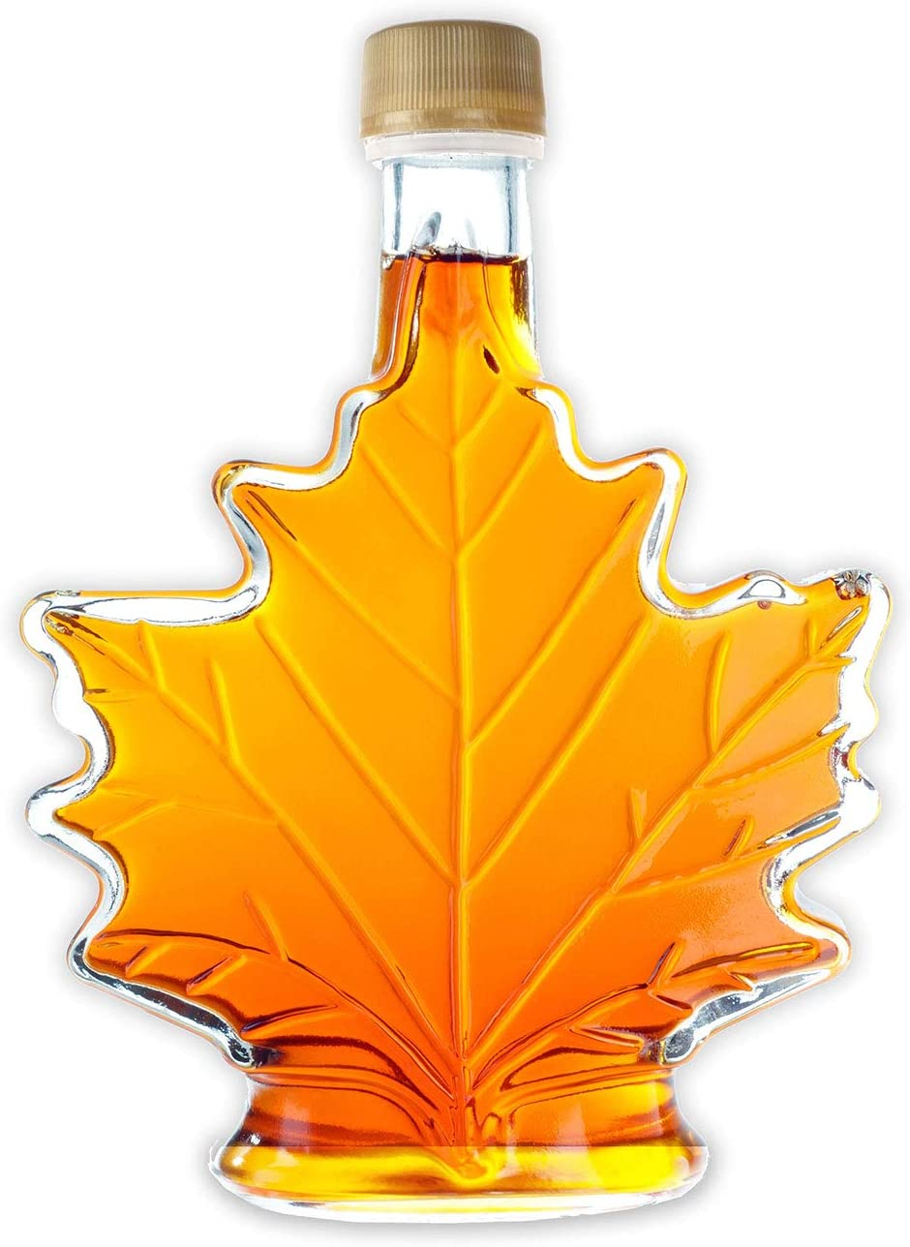
Introduction and Problem Statement
Main Objective
Sectors
Agriculture, Manufacturing, Energy, and Tourism
Understand drought factors affecting maple syrup production
Initial Ideas
Information Sources
NOAA, weather websites, college research websites
Golf course
New England livestock
Maple trees
Notes:
The purpose of this project is to figure out how maple syrup production in gallons is affected by drought and precipitation factors. Our primary focus will be on the northeast region, specifically seven states including Massachusetts, Maine, Vermont, New Hampshire, New York, Connecticut and Pennsylvania. The New England region is well known for its maple syrup production, and hence we will delve deeper into that area. We will analyze variables such as the annual crop production of maple syrup and other parameters related to climate change.
Organizations such as NOAA and third-party websites already provide publicly available data regarding drought parameters for all states. In addition, there are vast information sources regarding drought and different industries affected. We considered many sectors such as agriculture, manufacturing, energy, and tourism. Nonetheless, given that our team is based in Boston, we decided to focus on a sector that would be most relevant to our location. After researching the aforementioned sectors, we arrived at three final project ideas. The first idea was how drought affects business in golf courses in New England. Next, we thought about how drought conditions affect hay prices for livestock in New England. The third idea was drought affecting maple tree production in New England. Given the data scarcity regarding the other sectors and the relevancy of the project idea, we concluded that agriculture data regarding maple tree production would be the most suitable option.

Slide 4
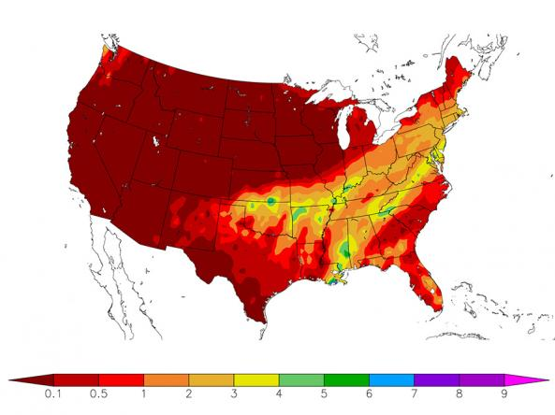
Data Overview
Data Sources:
National Oceanic and Atmospheric Administration (NOAA), United States Department of Agriculture (USDA), National Drought Mitigation Center
Dataset Information
22 variables
Notes:
Heading towards the data overview, our data was collected from several official website such as NOAA, USDA and National mitigation center

Slide 5
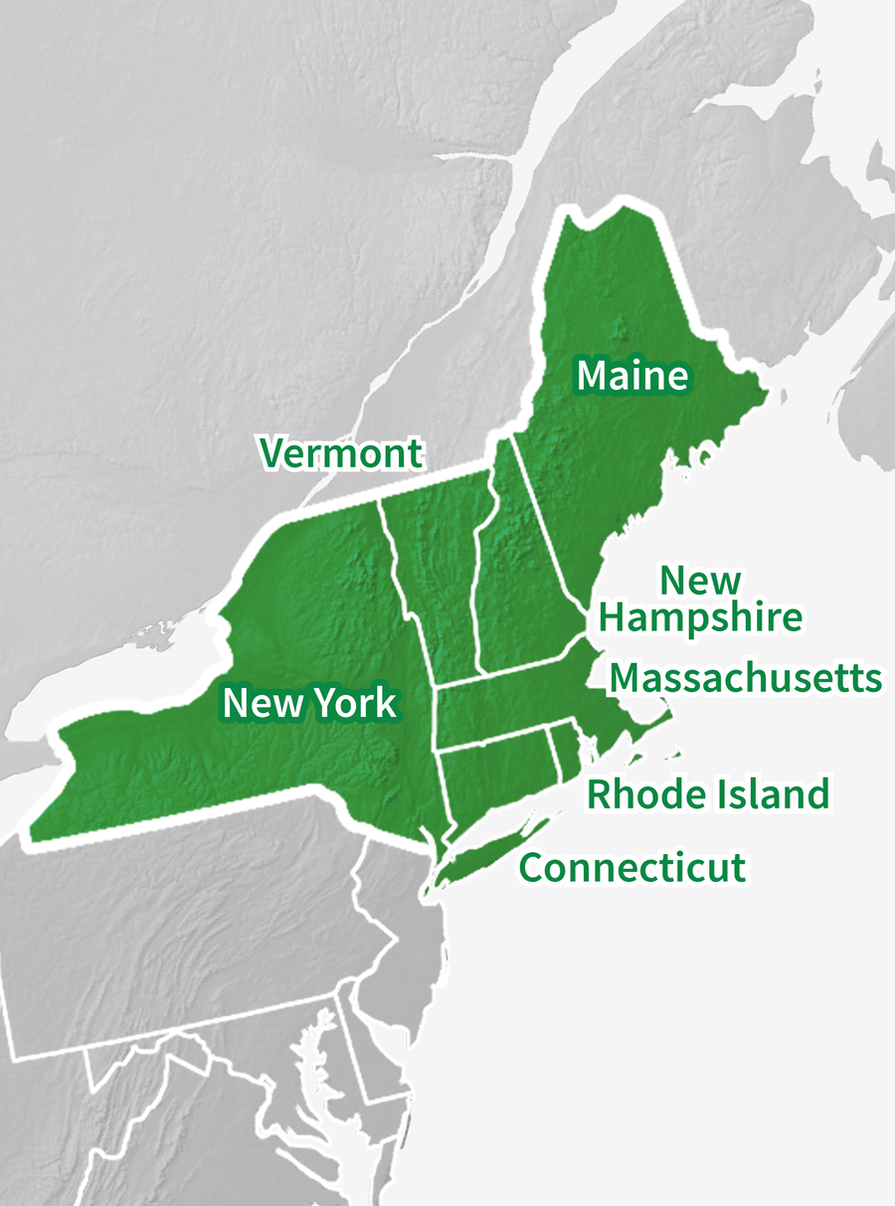

Data Overview
Drought-related Variables
01
None, D0, D1, D2, D3, D4, DSCI, SPI drought, SPI wet
Climate-related Variables
02
Average temperature, Extreme Air Temperature (Min & Max), Precipitation
Basic Information
03
State, Year
Production Data
04
Gallons, Value, Number of Taps, Yield per Taps
Notes:
D0: Abnormally dry
D4: Exceptional Drought
We can put those 22 variables into 4 categories; There are 9 variables are drought related variables. Each of them gives indication about a state’s drought level. For example, D0 represents % of area in this state that fall under abnormal dry; while D4 … Exceptional Drought
The second category contains climate related variables such as average temperature/ precipitation
The dataset also include some basic information such as State and Year.
The production related data includes gallons and value.

Slide 6
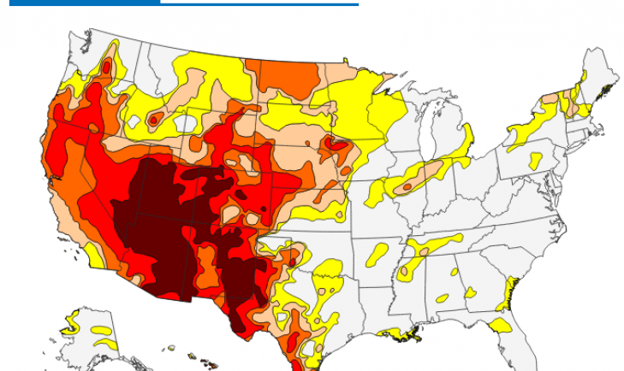
Data Preprocessing
Missing value: drought related variable for 64 rows (1992 to 1999)
Data processing goal:
Predict “None”, “D0”, “D1”, “D2”, “D3”, “D4”
Calculate DSCI
Input: SPI : W0-W4; SPI: D0-D4; ‘State’, ‘Year’, ‘Avg. Temperature’, ‘Precipitation’, ‘SPI-Drought state’, ‘SPI-Wet state’
Notes:
D0 - D4 introduction
D0: Abnormally dry
D4: Exceptional Drought
'W0','W1','W2','W3','W4','D0_SPI','D0_SPI','D2_SPI','D3_SPI','D4_SPI','Year','Avg. Temperture','Precipitation','SPI-Drought_state','SPI-Wet_state','CONNECTICUT','MAINE','MASSACHUSETTS','NEW HAMPSHIRE','NEW YORK','PENNSYLVANIA','VERMONT'

Slide 7
Feature Engineering
Accuracy Score
Train: 0.864
Test: 0.811
Assumption: D4 is 0
Abnormal Drought is not observed in the dataset
None
D4
Calculated by:
D3 = 1 - None - D0 - D1 - D2 -D4
Accuracy Score
Train: 0.732
Test: 0.622
D1
D3
DSCI
Calculated by:
DSCI = 1(D0) + 2(D1) + 3(D2) + 4(D3) + 5(D4)
Accuracy Score
Train: 0.643
Test: 0.324
D2
Notes:
D4: Exceptional Drought
Exceptional drought is rare
With increasing drought level, the accuracy score decreases. This is because the severe drought situation is less likely to be observed. The fluctuation in every single data point have a huge impact on the model. We cannot address this issue due to limited amount of data available to us. Therefore, we decided to calculate D3 level drought by the formula shown here. The key assumption made is that the D4 value is 0. This assumption is made since exceptional drought is rarely seen and it is always 0 in our dataset.
Randomness is fine for input
Same model (have impute data)
Impute data mising - > model

Slide 8
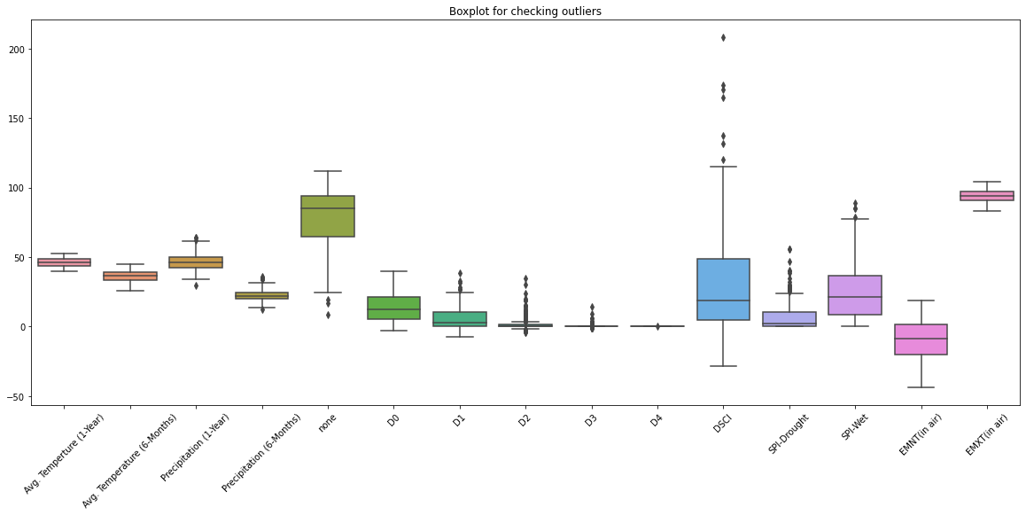
Outlier Check
Real Value
Did not drop for the further analysis
Notes:
# We used linear regression to fill in drought mitigator (none, D1-D4)
# There are none > 100 value; D1-D4 <0;
# We interpret that as a tendency towards more likely to be drought or not;
# Model can be useful for prediction in similar situation

Slide 9

Exploratory Data Analysis
01
Overall Production of Each State
02
Overall Correlation Heatmap
03
Average Temperature on Gallons
04
Average Temperature on Value
05
Extreme Maximum Air Temperature on Gallons
06
Extreme Minimum Air Temperature on Gallons
07
Average Precipitation on Gallons
08
SPI drought
Notes:
In the exploratory data analysis, we would explore every features we have in the dataset.
An overview of label -> overall production for each state
An overview of the correlation btw features
Temperature on production
Precipitation on production
Drought mitigator on production

Slide 10
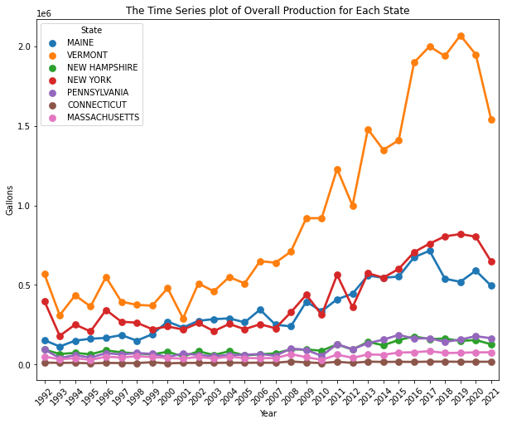


Overall Production of Each State
Top Three States:
Vermont
New York
Maine
Decline Period:
2010, 2012, 2021
Weather related
Overall Trend:
Increase
Stationary
Notes:
Drop missing value-- they don’t report

Slide 11
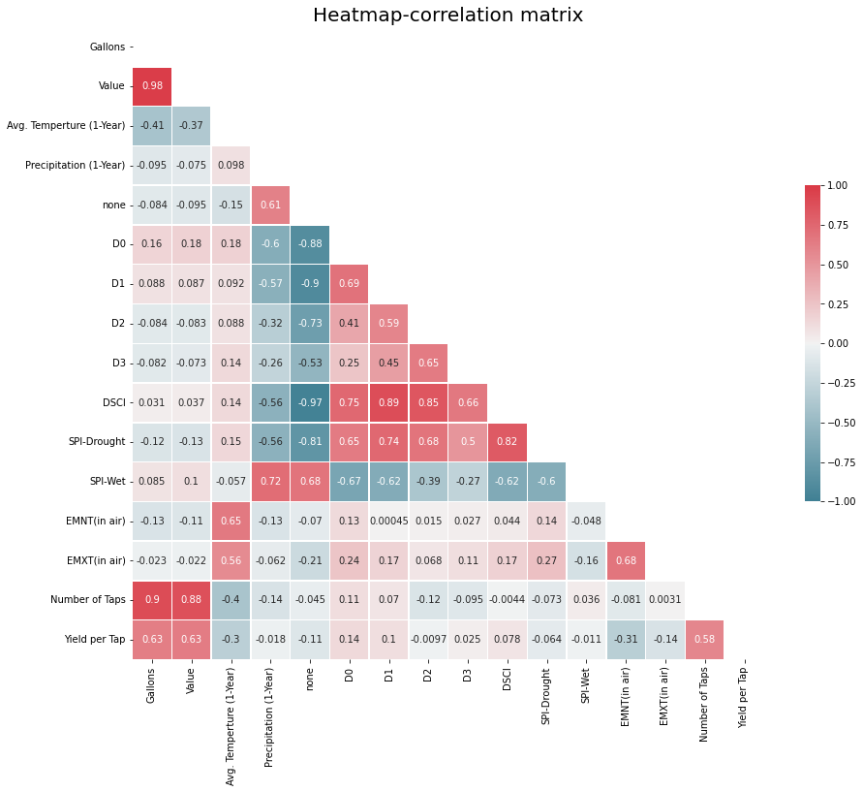
Variable Heatmap - Correlation Matrix
Positive correlation
Gallons vs Value
Negative correlation
Average Temperature vs Gallons
Average Temperature vs Value
Multicollinearity Issue
Drought-related variables

Slide 12
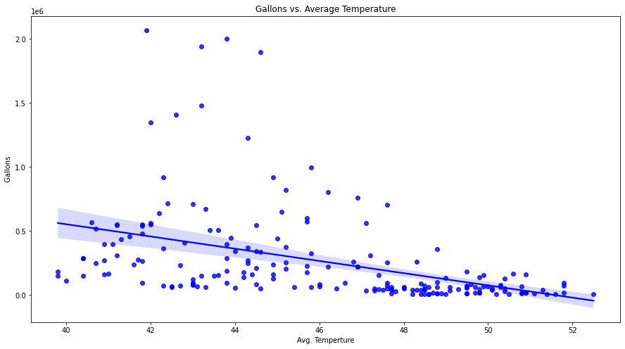
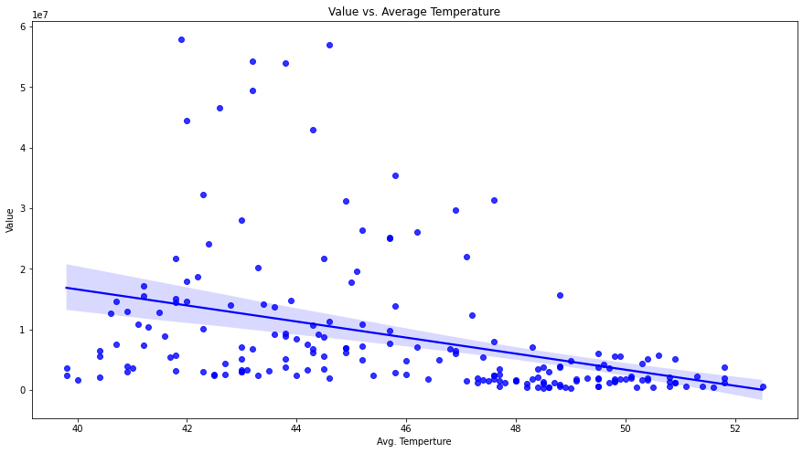
Average Temperature vs. Gallons/Value
Slope = -3.84
Slope = -1.10
Notes:
Negative correlation in both regressions. This supports the study from UW-Extension that warmer weather stops enzymes in tree roots from producing sugar in tree sap and could also lead to tree root damage, which leads to a reduction in gallon production.

Slide 13
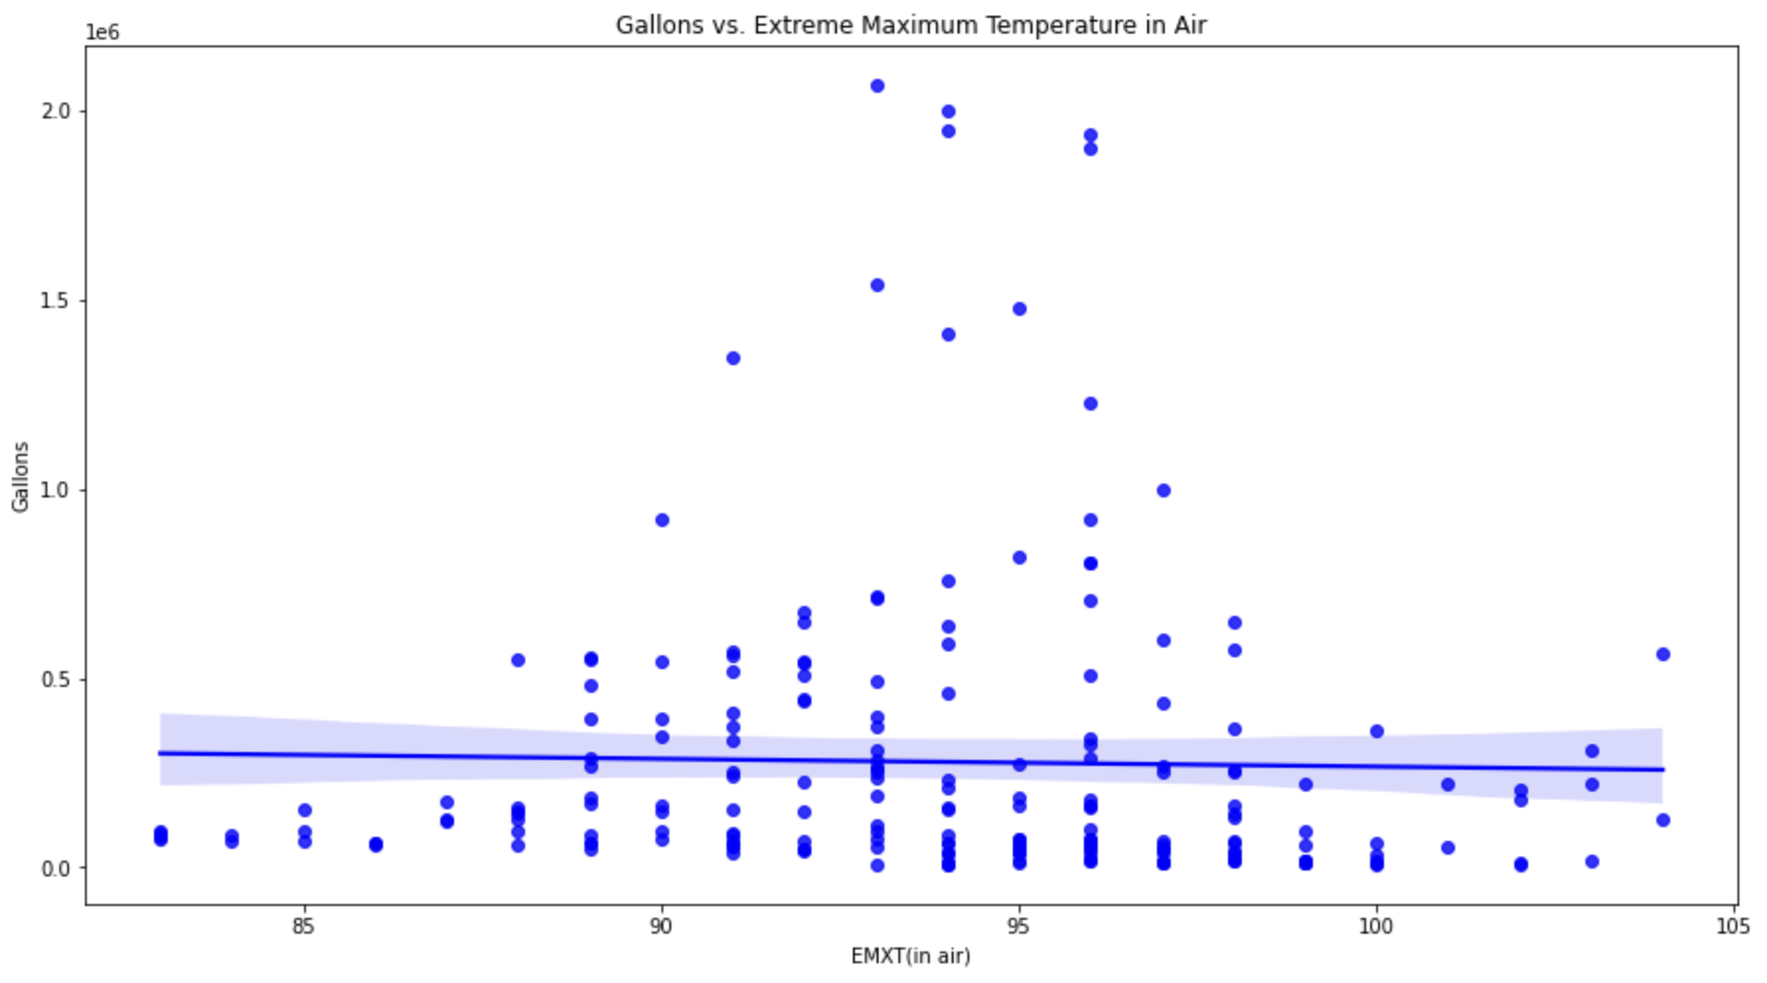
Extreme Maximum Air Temperature on Gallons
Slope = -3.84
Slope = -1.10

Slide 14
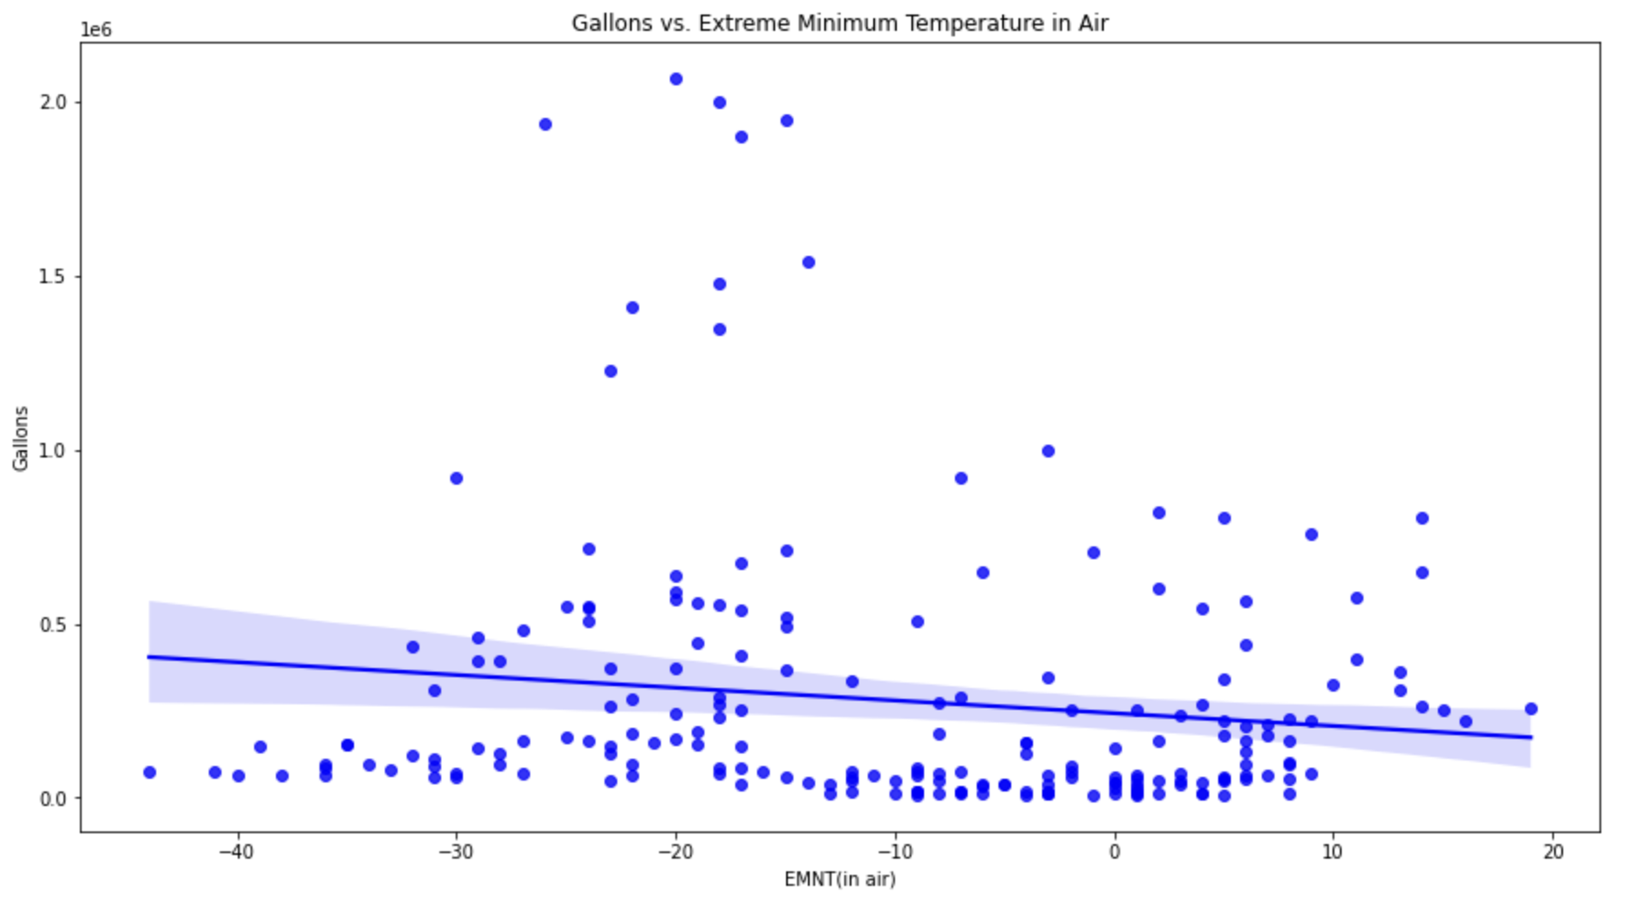
Extreme Minimum Air Temperature on Gallons
Slope = -3.84
Slope = -1.10

Slide 15
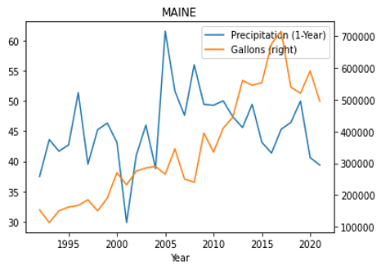
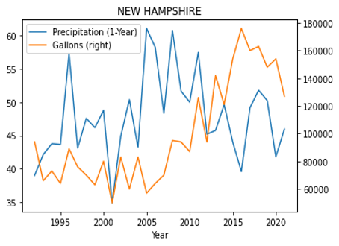
Precipitation vs. Gallons
Notes:
We then decided to discover the relationship between precipitation and production in gallons. Originally we assumed that the precipitation will stimulate the production by providing the more appropriate humidity for tapping.
However, for some states like Maine and New Hampshire, reduction of precipitation does not necessarily mean intense reduction of production. During 2016, the precipitation in both Maine and New Hampshire decreased dramatically while the production of those states during the year increased adversely. This is because apart from precipitation, other factors could affect the production of maple syrup such as warmer temperatures, health of the trees...So we looked up and discovered that According to the USDA 2016 maple syrup production report, ‘Producers were encouraged to tap earlier this season by the warmer than normal temperatures.’

Slide 16
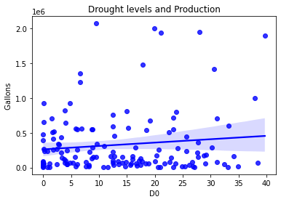
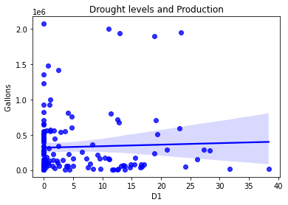
Drought Levels and Gallon Production
Notes:
Searching for a possible correlation between dry levels of drought and maple syrup production we find that there is no clear linear relationship between them. This is the case for all 4 levels of drought, from abnormally dry to extremely dry.

Slide 17
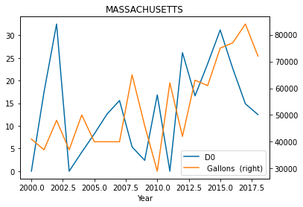
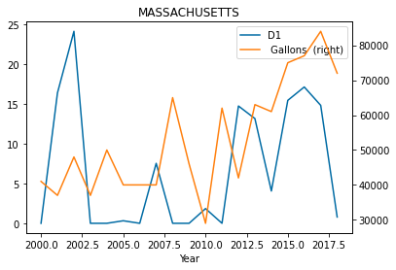
Drought Levels and Gallon Production
Notes:
Then we looked at these two parameters over time to find a meaningful pattern. During the early 2000s, there was an inverse relationship between D0 (Abnormally dry) levels of drought and gallon production. Over time, that relationsip became less inverse to the point where even with high levels of D0 drought did not impede high levels of production of maple syrup. One should not generalize about the relationship between D0 levels and maple syrup production when it comes to states in the northeast as not all states show the same behavior. With the exception of Massachusetts and Connecticut, for most northeast states, D0 and maple syrup production seem to be on the rise.
Similar to the relationship between D0 and production, D1 (Moderate Drought) levels also started as inverse to production in the early 2000s. Towards the mid-2000s and late 2010s there was not a clear relationship as both variables increased and decreased simultaneously.
During early 2000s, D2(Severe Drought) was high in most states. During middle and late 2000s D2 levels were essentially 0. During mid-2010s there is a spike in D2 levels again and towards late 2010s there seems to be an upward trend in D2 levels for most states, except Massachusetts and Connecticut.
It is difficult to generalize the relationship between D3 (Extreme Drought) levels and maple syrup production on the northeast as many states show an even more different behavior in terms of units of D3 levels. For some states D3 levels were essentially 0 for several years. One could argue that the reason for D3 levels to be minimal for many states is because extreme drought is not as common as lesser levels of drought, in the northeast.

Slide 18
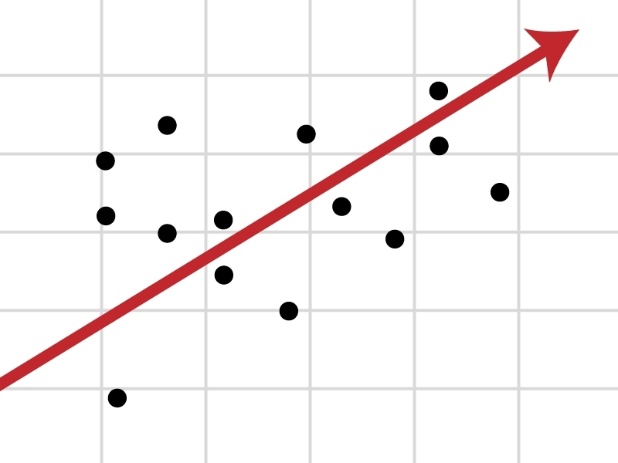
Regression Analysis
Regression of Each State
01
Multivariate Regression on all states
02
Notes:
Moving on, we are heading to the regression part. Since our dataset covers data from all the states in the northeast area, we ran regressions both from perspective of each state and Multivariate Regression of all states

Slide 19
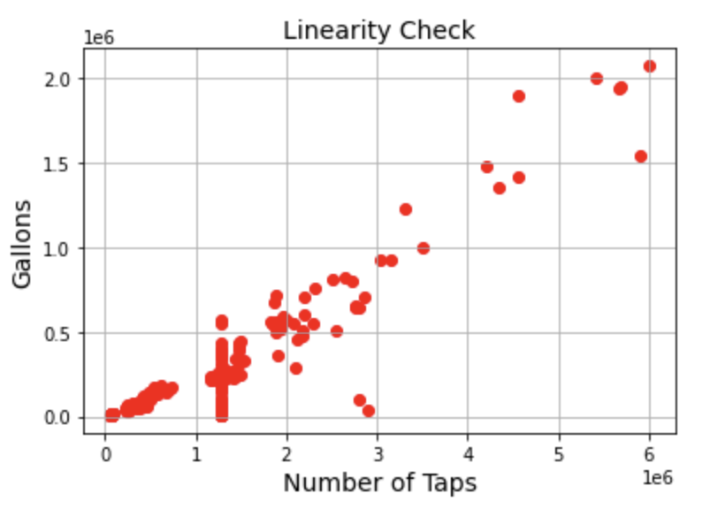
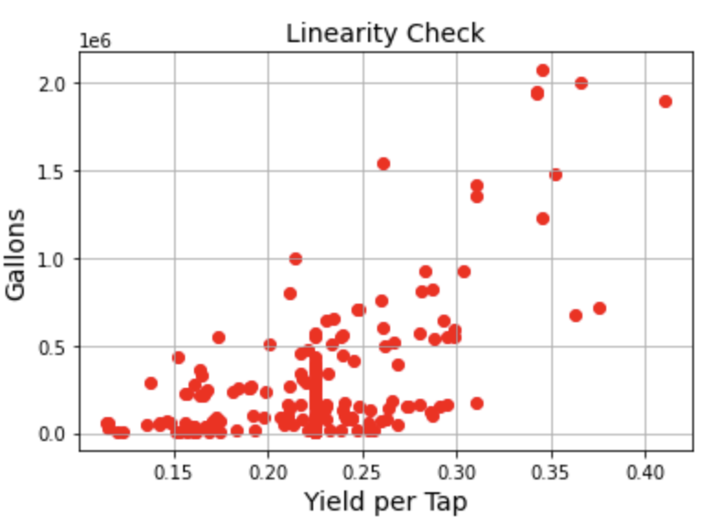
Linearity Check
Variables ‘Yield per Taps’ and ‘Number of Taps’ is highly related to target variable ‘Gallons’.
On average, a tapped maple will produce 10 to 20 gallons of sap per tap. →Linear relationship?
Sugar concentration variability might affect the final production in gallons! → Or not??
Notes:
Firstly we did a linearity check to eyeball the dataset to see possible linear relationships between variables and gallons. As you can see, For variables such as yield per taps and number of taps, the linearity is pretty obvious. This is because according to studies, a tapped maple will produce 10 to 20 gallons of sap per tap. It takes approximately 40 gallons of sap to produce one delicious gallon of fresh maple syrup.
However, according to our research, sugar concentration can affect the final maple syrup production and since sugar concentration of the sap can vary from 1 percent to as high as 5 percent, this will drastically impact how much sap it takes to produce a gallon of syrup.
https://nysmaple.com/how-much-sap-can-one-tree-produce/

Slide 20
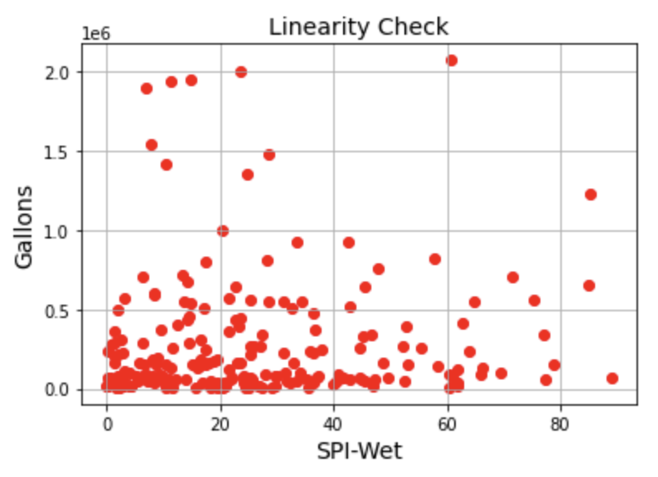
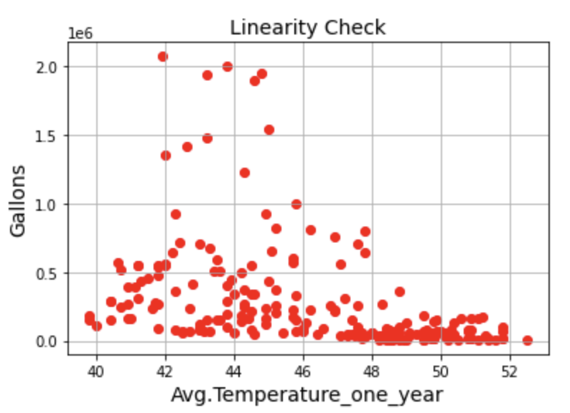
Linearity Check
Variables such as ‘SPI Wet’ and ‘Avg Temperature’ are distracting
However, in reality, ‘Drought conditions are harder on the trees than wet conditions. The wet ground will supply plenty of moisture for the sap to run but the drought may mean lower sugar.’
Notes:
Moreover, some variables seemed to be very distracting with no linearity showed at all. As you can see from the graph, variables such as SPI-wet and AVG temperature throughout the year are good examples. But this does not mean that these two variables are useless. Take average temperature as an example, although judging purely from the graph, these two variables are unrelated but according to our research, The ideal weather conditions for sap collection are daytime temperatures around 40 - 44 degrees Fahrenheit when the Sustained warm temperatures provide an environment for a rapid, massive release of sap by trees over a very short period of time.
http://mapletrader.com/community/showthread.php?33629-Sugar-in-sap-vs-prior-years-weather

Slide 21
Regression - Considering maple growing season
Growing season: Last year’s September to the second year’s February, but only precipitation!
Most of the states, R square increased!
Connecticut decreased dramatically!
Conclusion: Using precipitation during growing season and average temperature of the whole year!
State | R-square | R-square(growing season) | Difference
ME | 52.80% | 52.60% | -0.20%
VT | 76.40% | 82.70% | 6.30%
MH | 80.10% | 80.30% | 0.20%
NY | 57.50% | 58.00% | 0.50%
PA | 37.60% | 41.70% | 4.10%
CT | 49.90% | 42.90% | -7.00%
MA | 56.60% | 56.60% | 0.00%
Notes:
Next, moving on to regression analysis on each state, we took the maple trees’ growing season into consideration. Overall speaking, maple trees grow from last year’s September and this year’s Feburary, so we ran several regressions to see if using temperature and precipitation during this time span will actually improve our regression model. So after several attemppts, we decided that using the temperature of the whole year and precipitation during maple tress’ growing season would return the best results. As you can see from this table comparing the R-squared of each state using the two methods, for most of the states, r-squared increased but for connecticut R-squared decreased almost 7%. This is because for connecticut, a lot of the rains happen in May, June, July and thus using precipitation only in growing seasons will decrease the influence of this variable on production
after several attempts, we determined that the combination of using average temperature of the whole year and
http://mapletrader.com/community/showthread.php?33629-Sugar-in-sap-vs-prior-years-weather
https://www.bestplaces.net/climate/city/pennsylvania/philadelphia

Slide 22
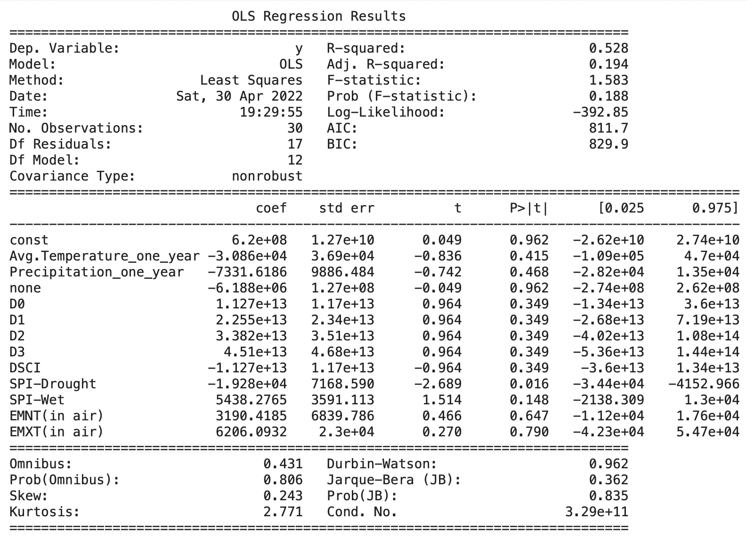
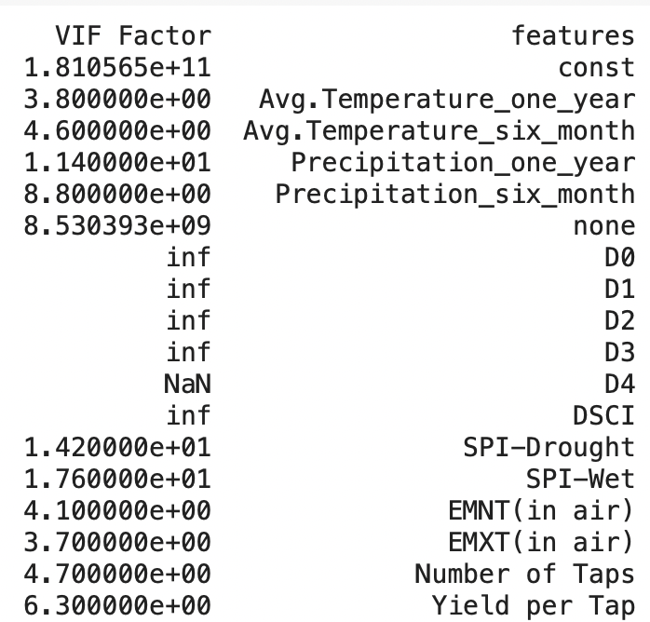
Feature Selection - Maine as an example
Eliminated D1, D2, D3, D4 because of these variables’ collinearity with the D0.
Kept DSCI for saving the overall drought effect on regressions
Notes:
Next, we are trying to see if any of these variables are insignificant so we did feature selection
After checking the significance of these features, we decided to exclude D1, D2, D3, and D4 because of these variables’ collinearity with the D0. The VIF factor table listed below showed that any factor larger than 10 should be eliminated. However, we kept D0 and DSCI after several attempts for better regression results.
http://mapletrader.com/community/showthread.php?33629-Sugar-in-sap-vs-prior-years-weather
https://www.bestplaces.net/climate/city/pennsylvania/philadelphia

Slide 23
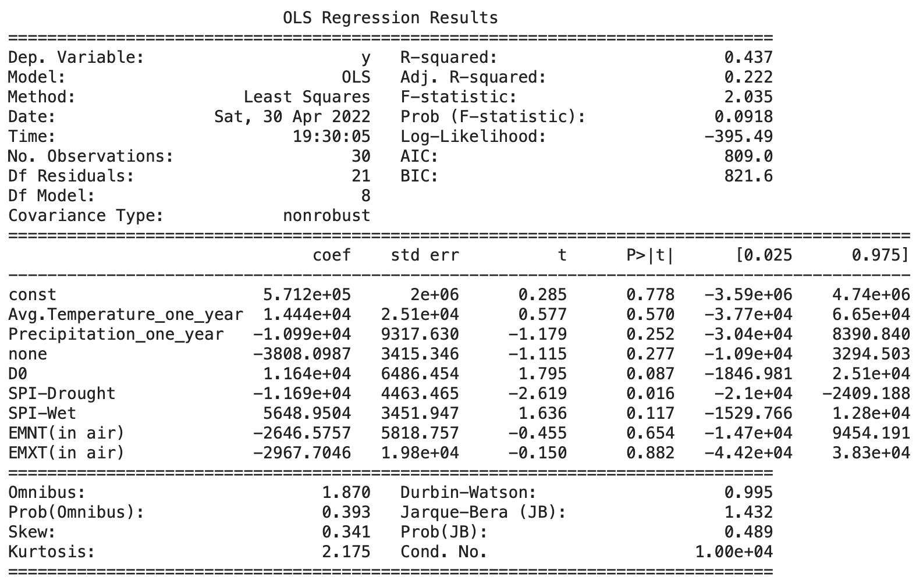
Feature Selection - Maine as an example
P value of D0 increased a lot!
The SPI drought stayed significant.
Variable ‘none’ is negative. → But not significant!
Limitation: Most of the variables still not significant!
Check lag effect!!!
Notes:
http://mapletrader.com/community/showthread.php?33629-Sugar-in-sap-vs-prior-years-weather
https://www.bestplaces.net/climate/city/pennsylvania/philadelphia

Slide 24
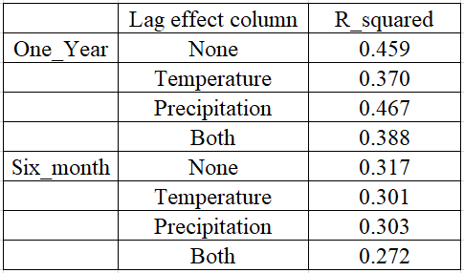
Lag-Effect Regression
None - No lag effect
Incorporating previous year’s precipitation explains more variance in maple syrup production.
However, this is not the case for average temperature.

Slide 25
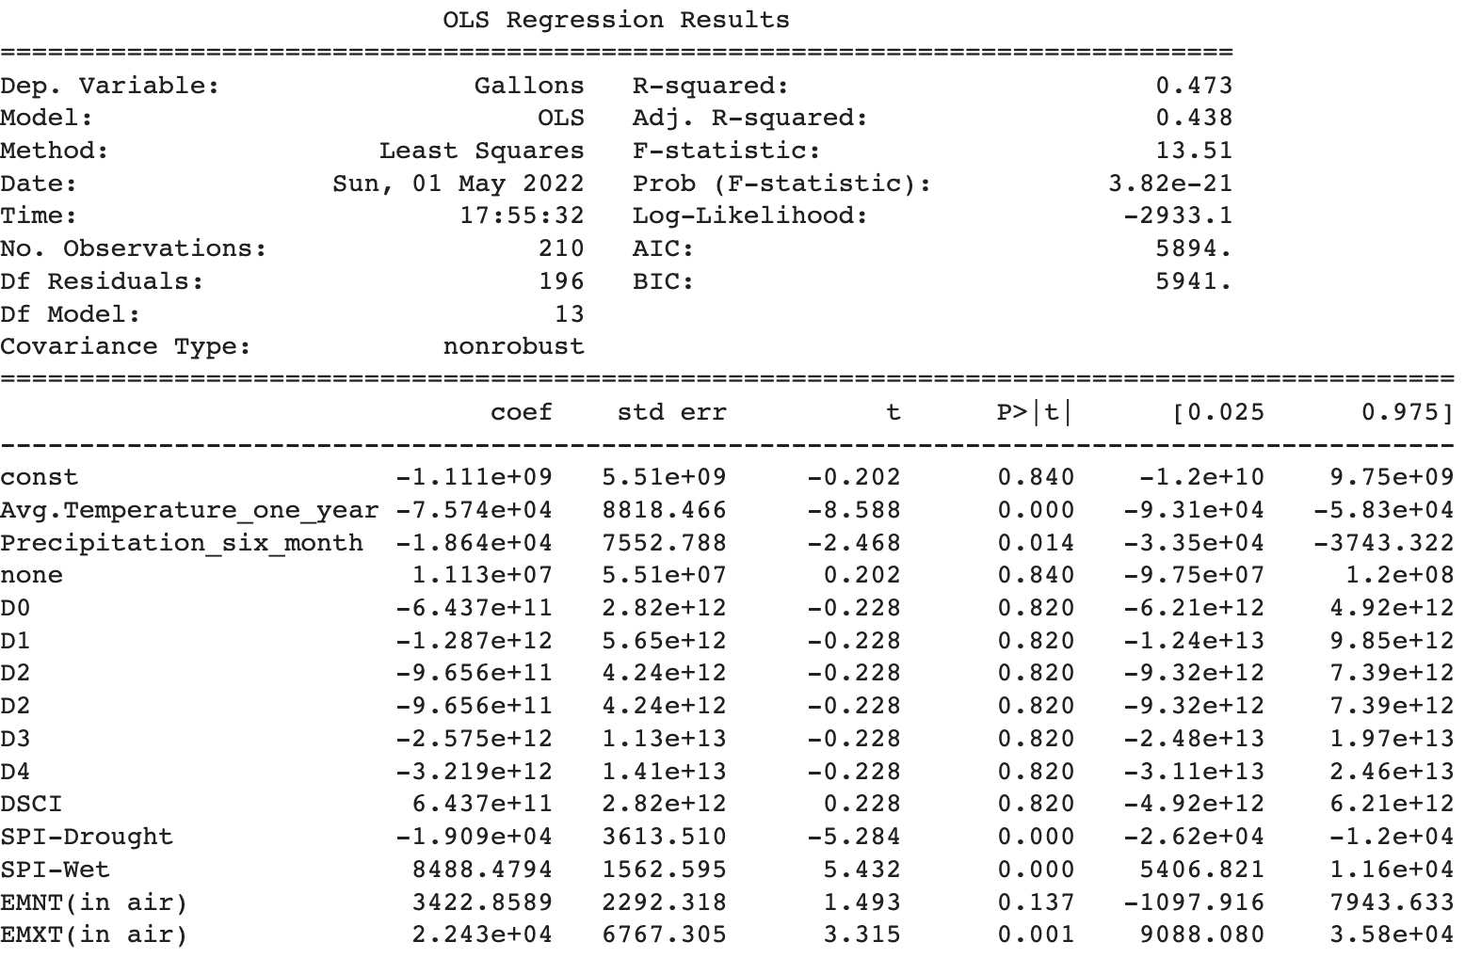
Multivariate Regression (All States)

Slide 26
Conclusions and Challenges
Conclusion
Average temperature (1-year), Precipitation (Growing Season), SPI Wet, SPI Drought, and Extreme maximum temperature were significant indicators that explained the variation in gallon production in all states.
Limitations and Challenges
Limited data volume to draw causal inference about how drought affects maple production or make accurate predictions on production with appropriate ML models.
Data granularity issues
Data sources had variables that were on different scale, different level, different years than desired.
Lack of response from maple syrup connoisseurs, maple syrup companies, or government agencies, farms.

Slide 27
Potential Improvements
Add more features (Soil, Geological variables etc.) to learn other factors that influence syrup production.
Find granular data (monthly, weekly, daily) to perform more accurate analysis.
Design dashboard (Tableau, PowerBI) for data visualization.
Create database to store and update data since our data is continuous.
Expand drought impact analysis on other crops - eg. apples, corn, soybeans.

Slide 28
THANK YOU

